Slide 1
Module Group Project IMDCGD111-16YRD Module managing games production imdcgd214-16yrd level 4/5 Group 13 Eat them
Heidi Falcon - George Flude - Macaulay Mills

Slide 2
Logline
Players aim to eat bubbles while avoiding obstacles and the first one to eat their opponent, wins.

Slide 3
Meeting the brief
2D adversarial simultaneous gameplay with symmetric design.
Use of buoyancy physics concept.
Simple and intuitive rules

Slide 4
Target Audience
16-25 either gender. Casual gamers
Fast paced, simultaneous gameplay which allows for social fun,
http://www.eldergame.com/2008/05/define-your-target-audience/
http://serious.gameclassification.com/EN/about/bricks.html#PUBLIC

Slide 5

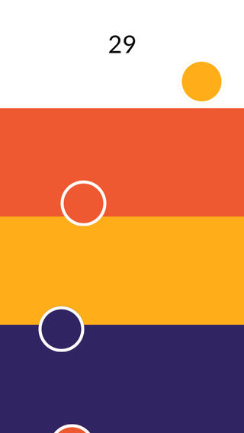
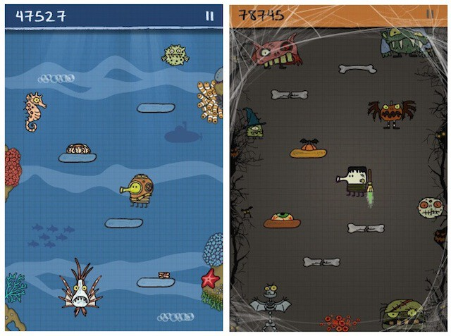
Research
We researched games and took inspiration from:
http://www.ologame.com/
https://itunes.apple.com/gb/app/circo/
http://doodlejump.org/

Slide 6
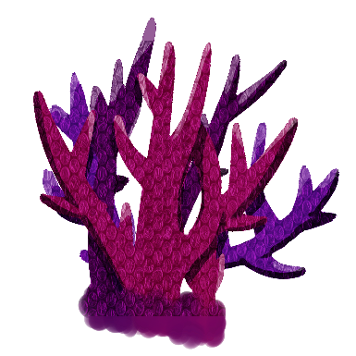






Mechanics and Assets
Gameplay
Eating/Absorbing
Throwing/Avoiding Obstacles

Slide 7
Physics
Buoyancy:
Players fight against a force of buoyancy, creating unpredictability in gameplay.

Slide 8
Emotions
Competitiveness: Giving the winner bragging rights
Struggle: Race to gain higher score, to avoid obstacle.
Strategy: Plan to position obstacles to hinder opponent.
Aggressiveness: Game requires players to concentrate on attacking as well as defending their environment.

Slide 9
Iterations
It was purely a game of skill
Spawning of obstacles
Grabbing mechanic allows for strategies to be planned
Thruster, can be improved on movement, so its not as predictable

Slide 10
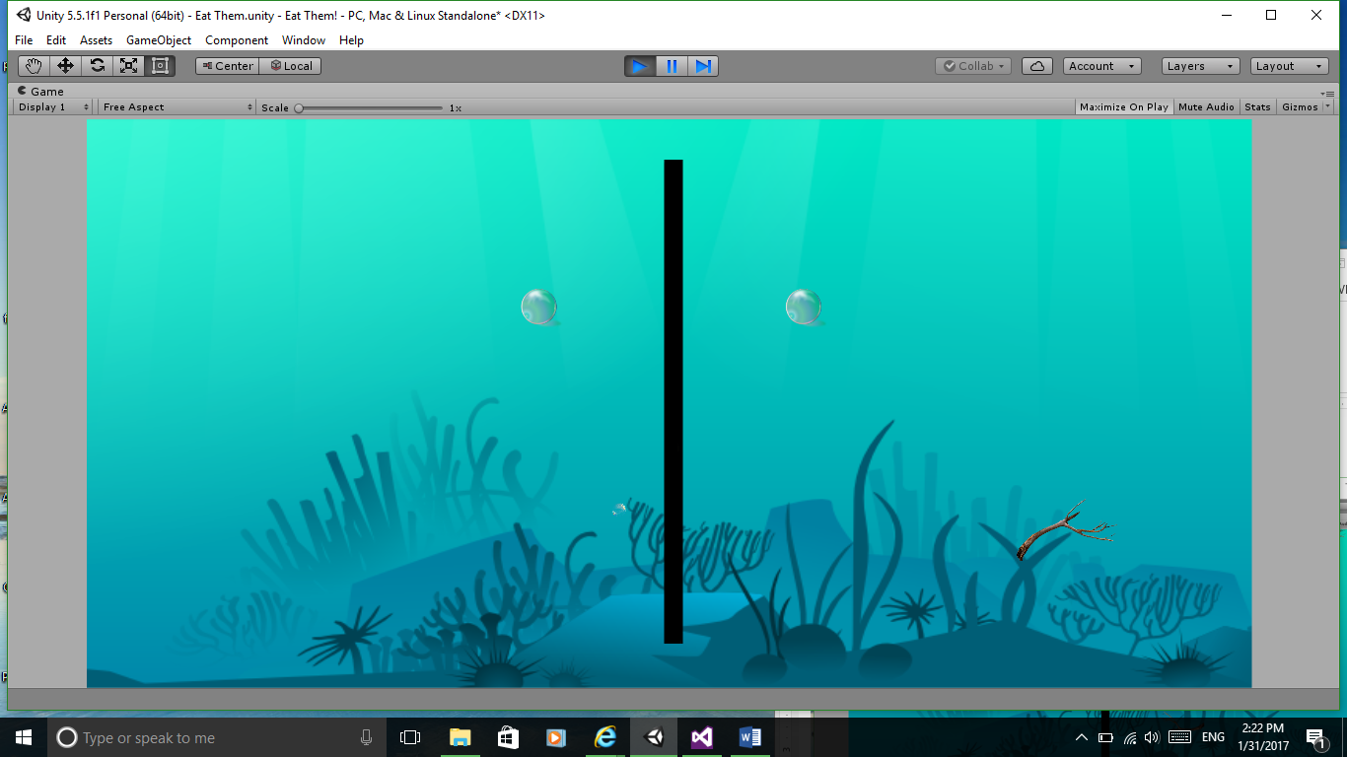

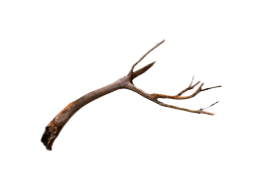


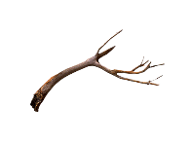

Prototype 1

Slide 11

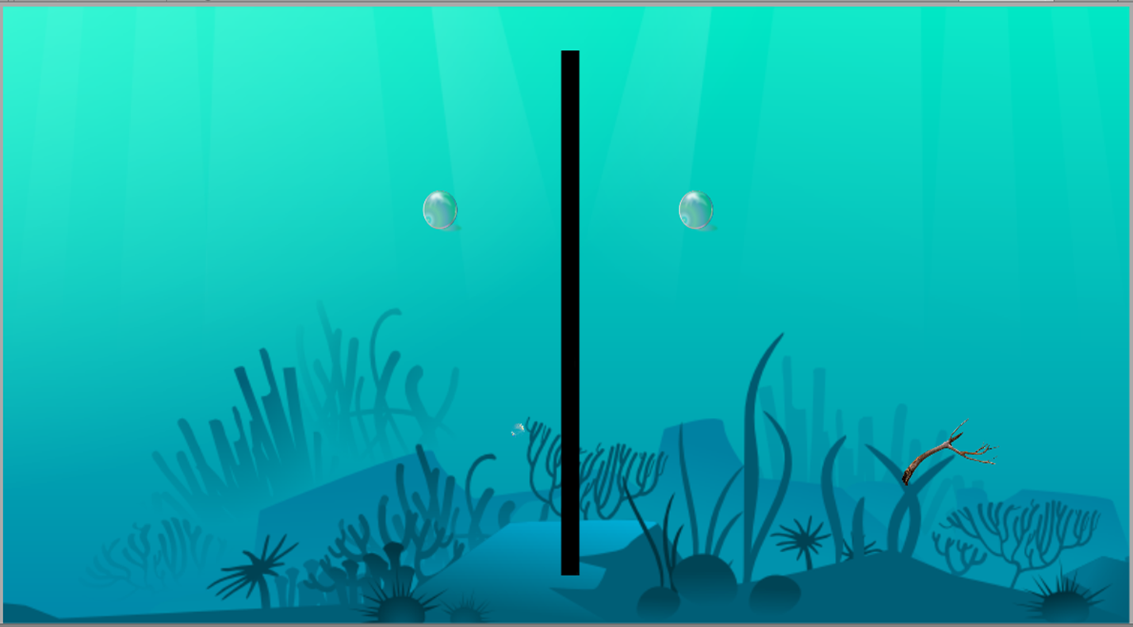


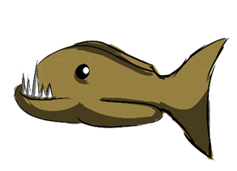
Prototype 2

Slide 12


Prototype 3

Slide 13
The Game

Slide 14
Playtest Feedback
Q-1 Liked? 80% Theme
Q-2 Didn’t like?
60% Controls
40% Screen too busy
Q-3 Implied instructions? 80% No
Q-4 Change?
60% Instructions/ Controls
40% Theme/ Player design.

Slide 15
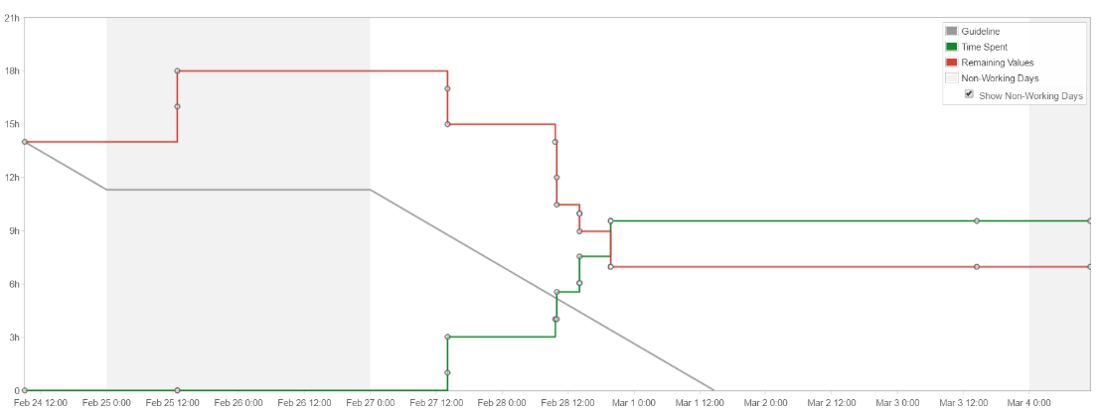
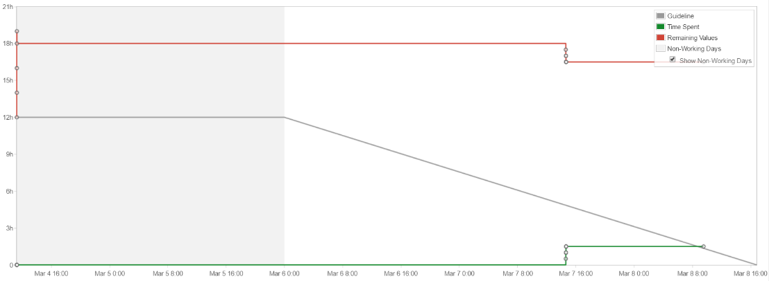
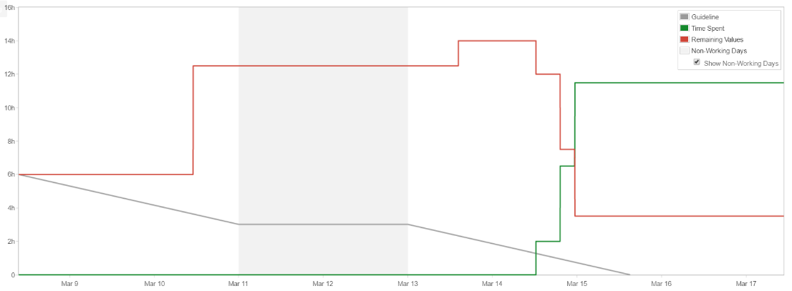
Management
Emails:
George: 39
Heidi: 42
Macaulay: 5
Hours logged:
George: 32
Heidi: 35
Macaulay: 0
Sprint 4
Sprint 5
Sprint 6

Slide 16
Final tasks
Polish sounds
Polish eating mechanics
Create timer
Polish buoyancy (Physics drive the game)
Playtest

Slide 17
Questions?

